Slide 1
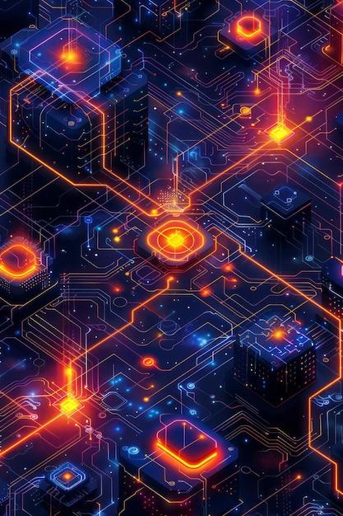

Public Blockchain Trends
2025

Slide 2
TRENDING
Real World Assets (RWA) Tokenization -Onboarding trillions in real estate, commodities, invoices, and securities onto the blockchain.
Layer 2 (L2) Dominance-Scaling Ethereum and other base layers with rollups and zero-knowledge tech.
Interoperability and Modular Chains-Composable blockchain stacks, cross-chain communication (IBC, bridges, shared sequencers,Polkadot,Cosmos).
AI+Blockchain- On-chain AI agents and AI-generated smart contracts.
Restaking and Shared Security-EigenLayer, Babylon, and other protocols enabling security as a service.
DePIN(Decentralised Physical Infrastructure Networks) - Decentralizing real-world resources like storage (Filecoin), energy, sensors, and telecom (Helium).
Web3 Social and Consumer Apps- Decentralized social media (Lens, Farcaster), on-chain reputation, and gamified consumer experiences.
Memes
‹#›

Slide 3


We have !!!!!!
RWAFactory
Bridging Physical Assets access with Blockchain

Slide 4
Problems
Traditional real-world asset (RWA) markets suffer from
Illiquidity and slow transactions
Inefficient ownership transfer
Lack of fractional ownership
High entry barriers & complex legal structures

Slide 5
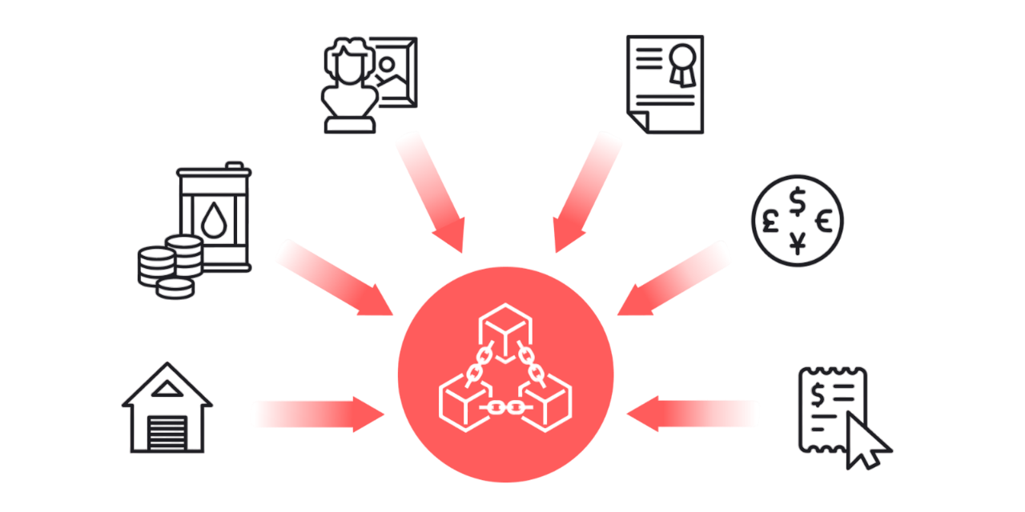
Solution
RWA Tokenization Platform Powered by Blockchain

Slide 6
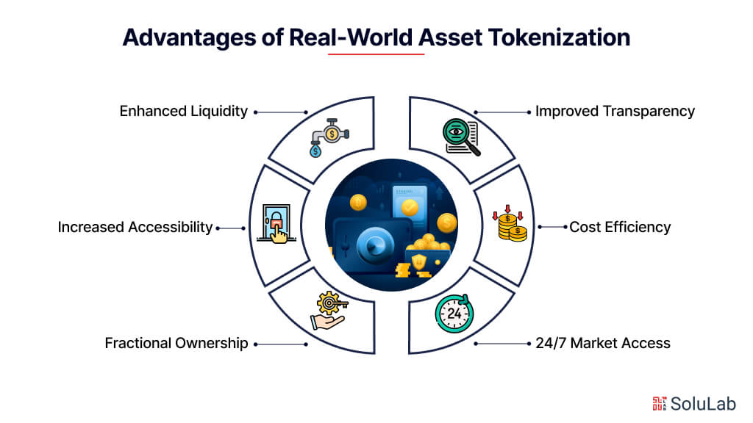
Solution.How??????
Blockchain-powered asset tokenization
2. Fractional ownership & seamless transfers
3. Secure leasing & selling via smart contracts
4. Tamperproof & Transparent Ledger

Slide 7
HOW IT WORKS?
Create an asset category (e.g., real estate, machinery, cruise)
Mint & Issue tokens representing ownership
Trade & Lease assets through a decentralized marketplace
Earn & Manage revenue streams with automated payments

Slide 8
Key Features
ERC-1155 Multi-Token Standard: Efficient handling of multiple assets
Access Control & Permissions: Roles for admins, sellers, buyers
Secure Payments/Leasing: Transparent revenue sharing & fee collection
Automated Platform Fees: Ensuring sustainability & scalability
Fractional Ownership: Reducing barriers to entry for investors

Slide 9
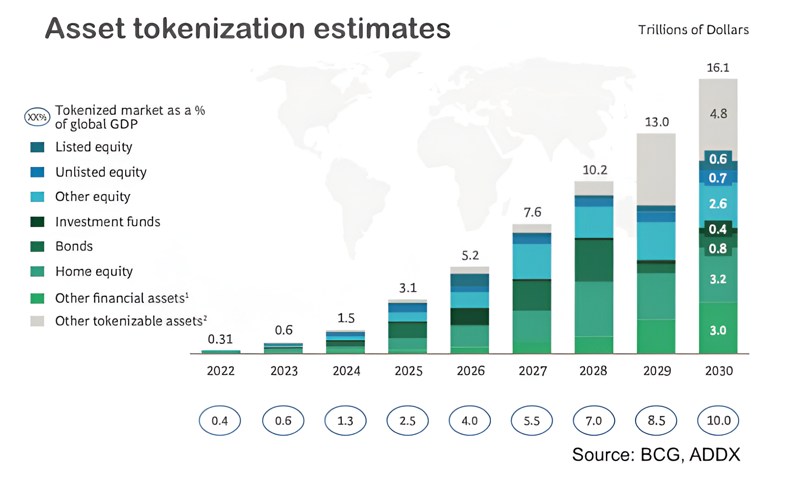
Market Opportunities
Global RWA tokenization market projected to reach $16 trillion by 2030 (Source)
Real estate, art, machineries, hospital equipment, luxury goods are prime for disruption
Increasing demand for alternative investments and fractional ownership (Source)
Growing acceptance of blockchain technology in traditional finance
Regulatory advancements supporting digital asset adoption

Slide 10
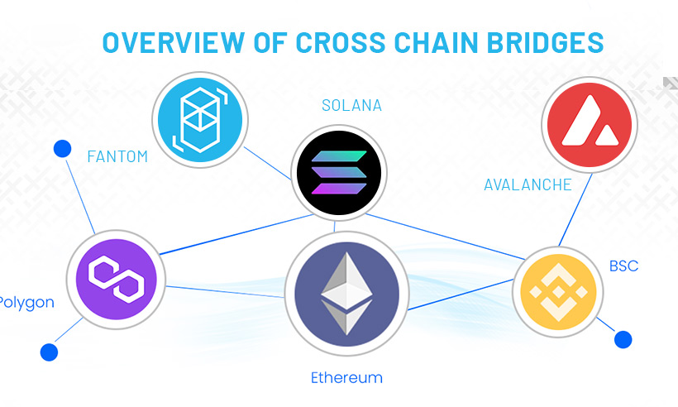
Business Model
Primary Revenue Streams:
Transaction fees on asset sales & leases (1%)
Premium access for institutional investors
API integration for enterprises
Scalability:
Multi-chain expansion (Ethereum, Polygon, BSC)
Institutional partnerships for large-scale adoption

Slide 11
Competitive Landscape
Company Name | Key Features | Notable Works
Brickken(https://www.brickken.com/en) | Specializes in tokenizing real estate and other physical assets. User-friendly platform. | Tokenized over $250M in assets; expanding globally. (Source)
Blockcsquare(https://blocksquare.io/) | ​Blocksquare is a leading provider of real estate tokenization infrastructure, offering a comprehensive suite of tools designed to digitize property assets efficiently. | Blocksquare partnered with FractioneX o explore new ways of making homeownership more accessible for first-time buyers. (Source)
Janus Henderson | Tokenizing short-term U.S. Treasury bills and integrating blockchain into asset management. | Managing $11M Anemoy Liquid Treasury Fund. (Source)
Lofty | Fractional ownership in real estate via tokenization. | Tokenized over 181 properties for fractional investors. (Source)

Slide 12
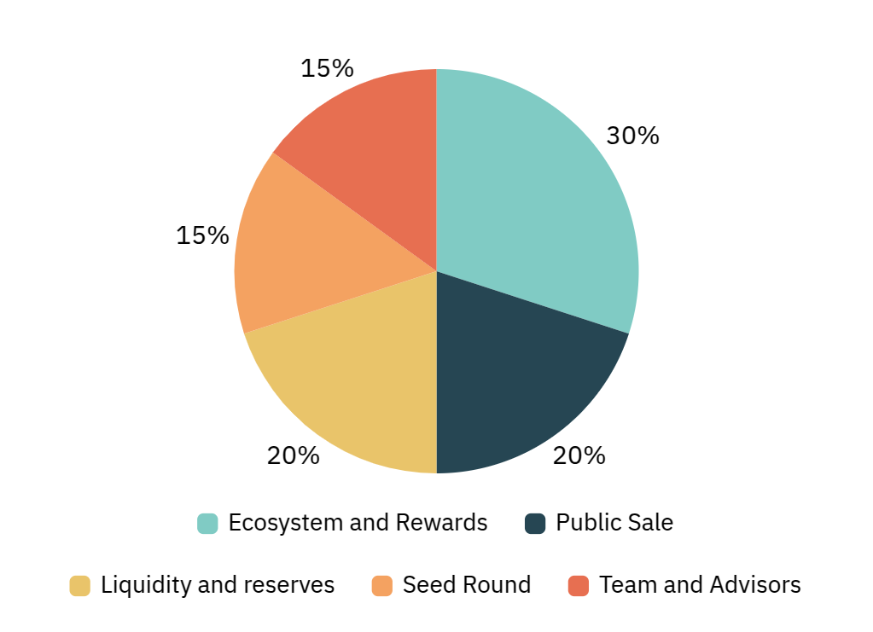
Token Economics
Token Utility:
Governance: Token holders can vote on key platform decisions
Staking: Earn rewards for staking tokens to secure the platform
Platform Fees: Reduced fees for payments made using native tokens
Incentives: Rewards for early adopters, liquidity providers, and active users.
Deflationary Mechanics:
Buyback & Burn: A portion of platform fees is used to buy back and burn tokens
Staking Penalties: Penalties for early unstaking.
Token Distribution:
Seed Round: 15%
Public Sale: 20%
Team & Advisors: 15% (vesting over 3 years)
Ecosystem & Rewards: 30%
Liquidity & Reserves: 20%

Slide 13
Go-To Market Strategy
PHASE 1
Launch Beta with Real Estate/Art/Machinery Tokenization
Website→Social Media →Private Sale→Public Sale →IDO
PHASE 2
Secure Strategic Partnerships (Banks, Real Estate Firms,Art Galleries)
MeetsUps/Events→Protocol Partnerships→Service Partnership
PHASE 3
Expand to other sectors & Ensure Regulatory Compliance
Healthcare Equipments, Bonds, Cruise etc.

Slide 14
Challenges
⚖️ Regulatory Uncertainty – No clear legal framework for RWA tokenization or crypto assets
and Taxes in India. Need to set up entities in crypto friendly locations like
Dubai,Estonia,British Virgin Islands , Malta , Portugal, Puerto Rico.
🧷 Trust Building – Need heavy focus on audits, legal backing, and transparent
documentation to gain user trust.
📲 Community Building – Need to set up Telegram,Twitter, Discord, Reddit, Medium, WhatsApp,
Linkedin.
🧑‍🏫 Investor Education Gap – Low familiarity with blockchain, tokens, or asset digitization among retail
investors.

Slide 15
Public Blockchain Services Vara can provide
RWA Asset Tokenization
NFT Marketplace,Meme Coins development,planning and launch.
Decentralized Application Development on EVM Compatible Blockchains
Application Specific Blockchain on Cosmos and Polkadot ecosystem
Smart Contract Audits
Decentralized Exchanges
Lending and Borrowing Protocols (ex- Aave)

Slide 16

Join Us in Revolutionizing Asset Ownership
MUMBAI | GURUGRAM | KOLKATA
Follow us
www.varatechnology.com

